Slide 1

BIKE SHARING DEMAND ANALYSIS USING EXCEL
Presented By:
SANYAKUMARI
Position:
Data ANALYTICS
Organization:
Nexthikes IT Solutions
Project:
Bike Sharing Demand Analysis
sanyakumari521@gmail.com

Slide 2
Project Over view
Analyze bike-sharing Demand Identify Rental Pattern in Total Bike Rentals.
Study Time Base Demand Analyze How Rentals Change by Hour, Time group, Weekday and Working Days.
Analyze Weather Impact Examine the relationship between temperature, humidity, wind speed and weather conditions and bike rentals.
Compare User Types Analyze The Rental Behavior of Casual and Registered Users.
Create Build interactive dashboard Create KPI’S , PivotTables, Slicers and Timeline for Interactive Analysis.
Apply Advanced Analysis Use Descriptive Statistics, Correlation Analysis, forecasting and anomaly detection to Generate Useful Business Insights.
Support Business Planning Use the identified patterns to support demand planning, resource allocation and operational decisions.
Tools Used : Excel | Power Query | PivotTables | Pivot Charts | Dashboard | Forecasting | Anomaly Detection.

Slide 3
Dataset Workflow
Tools Used: Excel | Power Query | Data Cleaning | Data Validation.
Dataset_1: Bike-sharing rental records containing key rental and time-related information.
Dataset_2: Weather-related information such as temperature, apparent temperature, humidity and wind speed.
Dataset_3 : Additional bike-sharing records used for further analysis and data integration.
Dataset_1 + Dataset_2 → Merge Queries.
Dataset_3 → Append/Combine → Final Dataset.
Data cleaning : Checked and cleaned raw data before analysis.
Missing values : Identified blank/null values and handled them appropriately.
Duplicate Checking: Checked duplicate records to maintain data accuracy.
Data Type Correction : Corrected Date, Time, Number and Text data types.
Final Dataset : The clean and integrated dataset was prepared for PivotTables, Charts, Interactive Dashboard, Forecasting, and Anomaly Detection.

Slide 4
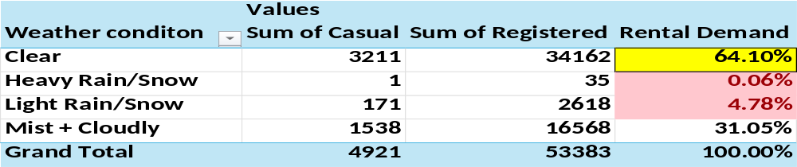
Pivot Table
PivotTables: Summarized rental demand based on Temp, Atemp, Humidity, Windspeed, weather, time, date, and user type.
Weather Condition Analysis.
Clear weather accounted for the highest rental share (64.10%), followed by Mist + Cloudy (31.05%). Overall, rentals were concentrated in these conditions, with Registered users contributing more than Casual users.

Slide 5
Date-Wise Rental Demand
Rental demand fluctuated from 1 January to 14 February 2011, peaking on 25 January (1,985 rentals; 3.40%), followed by 20 January (1,927; 3.31%) and 11 February (1,746; 2.99%). Registered users contributed the majority of rentals.

Slide 6
Hour Wise Demand Rental
Overall, rental demand peaked at 5 PM (10.58%), followed by 8 AM (9.24%) and 6 PM (9.06%). Registered users peaked at 5 PM (5,774 rentals), while casual users peaked at 3 PM (536 rentals). Demand was lowest at 4 AM (0.12%) and 3 AM (0.26%).

Slide 7
Temperature Wise Demand
Highest rental demand occurred at normalized temperature 0.20 (13.59%), with relatively high demand between 0.16 and 0.24. Overall, moderate temperatures were associated with higher bike rental demand.

Slide 8
Atemp Wise Demand
Highest rental demand occurred at normalized Atemp 0.2273 (12.02%), with relatively high demand between 0.1818 and 0.2273. Overall, moderate apparent temperatures were associated with higher bike rental activity.

Slide 9
Humidity Wise Demand
Highest rental demand occurred at humidity 0.47 (5.51%). Demand fluctuated across humidity levels, showing no consistent pattern compared with temperature-related demand.

Slide 10
Windspeed wise Demand
Rental demand was highest at wind speed 0 (13.46%), indicating that lower wind speeds were generally associated with higher bike rental activity, despite some fluctuations.

Slide 11
BIKE SHARING RENTAL Dynamics REPORT - 2011
TOTAL RENTALS
TOTAL CASUAL
TOTAL REGISTERED
TOTAL COUNT OF RECORD
58304
4921
53383
1000

Slide 12
Dashboard ANALYSIS
KPIs: Total Rentals (58.3K), Registered Riders (53.4K), Casual Riders (4.9K), Average Daily Rentals (58), and Total Records (1K).
Demand Analysis: Charts display rental trends by hour, temperature, month, holidays, weekdays, weather conditions, and dates.
Interactive Filters: Slicers and Timeline allow dynamic filtering by hour, month, temperature, weekday, weather, and date.
Forecasting & Anomaly Detection: Clicking the respective sections opens their Excel sheets for detailed forecasting and anomaly analysis.
Business Insights: The dashboard helps identify rental patterns, peak-demand periods, and unusual demand changes for better business planning.

Slide 13
Descriptive Statistics
Temperature and Atemp values were relatively stable.
Humidity and Windspeed showed moderate variation.
Casual rentals showed strong right-skewness (3.41).
Registered rentals were also right-skewed (1.30).
Total rentals: Mean 58.3, Median 49, SD 50.99.
Overall, rental demand varied considerably, with occasional high-demand observations.

Slide 15
Correlation
Temp & Atemp: Very strong positive correlation (0.918).
Temp & Count: Weak positive correlation (0.234).
Atemp & Count: Weak positive correlation (0.192).
Humidity & Count: Weak negative correlation (-0.256).
Windspeed & Count: Very weak positive correlation (0.105).
Overall: Weather variables showed mostly weak correlations with rental demand.

Slide 17
Forecasting
Historical
Future Forecast
01 Jan To 14 Feb – 2011
Actual rental data
Demand High fluctuations
Peak = 1,985
Actual observations.
15 Feb TO 15 Mar-2011
Estimated rental demand
Relatively stable pattern
End forecast = 1,506
Model-based estimates.

Slide 18
Fore Casting Chart

Slide 19
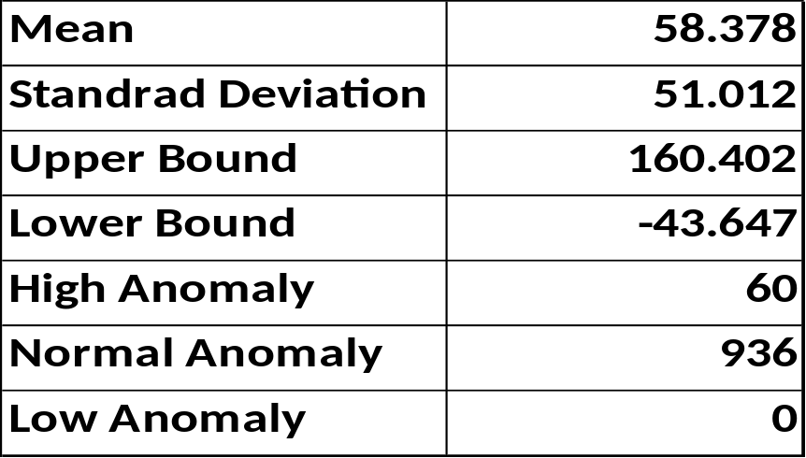
Anomaly Detection
Anomaly detection identified 60 high-anomaly observations out of 996 total observations, while 936 observations were classified as normal. No low anomalies were detected because the calculated lower bound (-43.647) was below the possible rental range. High anomalies represent unusually high rental demand and can be investigated for potential demand spikes.

Slide 20
Anomaly Detection

Slide 21
Decision Making / Recommendations
Customer Management
Prioritize registered users and encourage casual users through membership offers.
Future Demand Planning
Use forecasting to plan bike availability and resources during peak-demand hours.
Anomaly Management
Investigate the 60 high-anomaly observations to understand unusual demand spikes and prepare for similar situations.
Continuous Monitoring
Use the interactive dashboard, KPIs, Slicers, and Timeline to monitor demand and update analysis with new data.
Decision Making
Maintain more bikes during peak hours, use low-demand periods for maintenance and redistribution, and use weather, forecasting, and demand patterns to support better business decisions.

Slide 22
Business Insights
Peak Demand: 8 AM and 5–6 PM
Registered users: Major Contributor
Moderate Temperature: Higher Demand
Low Wind speed: Comparatively Higher Demand
60 High-Demand Anomalies: Investigate Demand Spikes

Slide 23

Thank You

